Slide 1
Network economics: the hardware/software paradigm, winner-takes-all-markets and technological standard wars.
Luca Grilli
L. Grilli, Politecnico di Milano –Network economics

Slide 2
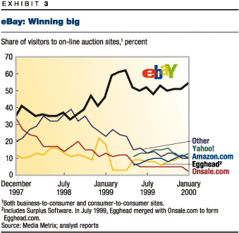

Slide 3
Cars
Smartphone OS

Slide 4
WINNER TAKES ALL MARKET!!!!!!!
(no second best prize market)

Slide 5
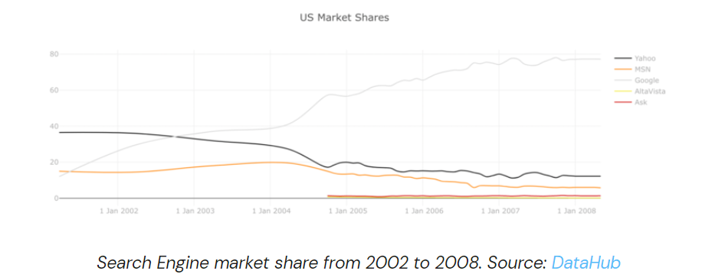
…..Another example of a W-T-A market dynamics

Slide 6
An introductive example:
The story of the garbage bin

Slide 7
GARBAGE BIN
In the town there are six guys that like playing videogames, Alan, Bud, Charlie, David, Eliah, and Frank.
Their utility function is characterized by externalities: their preferences depend on the intrinsic value of the game console plus a bonus that depends on the number of other guys owning the same type of console (why? because they can exchange games, challenge friends, and have a greater variety of games) .
Network externality

Slide 8
GARBAGE BIN
U_{i} = X_{k} + w*N_{k}
X_{k} = intrinsic value,
N_{k} = number of consumers owning type k console,
w = parameter (let us say, w=0.2)

Slide 9
GARBAGE BIN
k = a, b, c (3 different consoles)
Each firm invested in R&D for its own console and managed to patent some product features.
Each firm also invested in marketing and advertising.
STANDARD WAR

Slide 10
GARBAGE BIN
Yesterday, the guys received the catalogues, illustrating technical features
Therefore, tonight the guys will read the catalogues, assign their preferences (intrinsic value X_{k}) and make their consumption decisions.
They will assign different preferences to different consoles, since they value different characteristics.

Slide 11
GARBAGE BIN
When they fall asleep,
their structure of
preferences is:
N.B.:
this is only X_{k}, since there is no externality until the first customer purchases the first console
 | A | B | C | Pref
Alan | 0.4 | 0.6 | 0.5 | B
Bud | 0.6 | 0.5 | 0.4 | A
Charlie | 0.5 | 0.4 | 0.6 | C
David | 0.4 | 0.6 | 0.5 | B
Eliah | 0.6 | 0.5 | 0.4 | A
Frank | 0.5 | 0.4 | 0.6 | C

Slide 12
GARBAGE BIN
What is market structure (potential) on the Sunday night when they fall asleep?
A
33 %
B
33 %
Market
C
33 %

Slide 13
GARBAGE BIN
Charlie’s cat is very hungry on the monday morning and happens to turn the garbage bin upside down.
Charlie wakes up suddenly, it is 8 am. The other guys in town are still sleeping.
Charlie thinks “since I am awake, I might go to the games shop and buy my console”.
He goes and his purchase decision is obviously to buy C.

Slide 14
GARBAGE BIN
From the very moment Charlie makes his buy, the utility of other customers is changed.
The second customer is very likely to buy C.
If he does so, the third will CERTAINLY buy C and the market is locked in.
 | A | B | C | Pref
Alan | 0.4 | 0.6 | 0.7 | C
Bud | 0.6 | 0.5 | 0.6 | A/C
Charlie | 0.5 | 0.4 | 0.6 | C
David | 0.4 | 0.6 | 0.7 | C
Eliah | 0.6 | 0.5 | 0.6 | A/C
Frank | 0.5 | 0.4 | 0.8 | C
C wins and takes ALL the pie

Slide 15
Open questions
What if Charlie was the dull guy in town? (C is the worst game console)
What about company A & B?
Are companies happy with such an high risk profile of competition? (winner takes it all)

Slide 16
FURTHER CONSIDERATION
Note that one does not necessarily has to introduce complete dullness of agents in order to admit the possibility of a prevailing inferior network technology. First introduced by Arthur (1989, EJ), then also discussed by Leibowtiz and Margolis (1995, JLEO).
But it remains a theoretical possibility…..
Very difficult to prove…..

Slide 17
FURTHER CONSIDERATION
Of course there are missing elements in the story, but you can already infer the role of past and casual events on today situation:
How can we define business processes where a cat and a garbage bin are so important for determining the final outcome of the market?

Slide 18
Network markets
Network externality
Strategic choice between compatibility and incompatibility
Switching costs & technology replacement
Significant economies of scale

Slide 19
Network externality
Definition of network externality: a good exhibits a network externality when the positive change in the utility a consumer derives from it raises as the number of consumers that purchase the same product increases.
Examples: telephone, email, hardware-software, party, etc.
Difference between direct vs. indirect network externality:
Direct externality: the value of the good increases automatically as the number of users increases (examples: phone or e-mail). Generally, the good has no intrinsic value.
Indirect externality: the value of the good increases as the number of users increases but only in the presence of economies of scale in production (of software) because of a greater offer of complementary products (or a better quality) of the good (admitting that consumers care for software variety). In this case, the good has often an intrinsic value.

Slide 20
Distinction between a “two-way” and a “one-way” network
(Economides, 1996, IJIO)
Direct
2-way network: all the networks where service AB is different from the service BA (they represent two different goods). Each knot of the network represents a user.
B
Individual A
C
X
…
D
The value of the network is a function of the active links inside the network.
In a 2-way network composed by n knots, there are n(n-1) potential links. The entry of a new user produces a positive externality on existing users, since she adds 2n new potential links.
Metcalfe’s Law: if a network is composed by n users and each user assigns a value to the network which is proportional to the number of users
the value of the network V = f(n²-n)
If n is large → V = f(n²)

Slide 21
Excursus (A continuous formulation of Metcalfe’s Law – Rohlfs 2003, p. 215)
i = 1,….., N
W =

Slide 22
Metcalfe’s law
VN
Relationship between number of users and value of the network implied by the law
n
VN
True relationship
Metcalfe law could overestimate the value of a network
n

Slide 23
Distinction between a “two-way” and a “one-way” network
(Economides, 1996, IJIO)
Indirect
1-way network: When one of AB or BA is unfeasible, or does not make economic sense, or when there is no sense of direction in the network so that AB and BA are identical, then the network is called a one-way network.
A₁
hardware-software paradigm: the greater the usage of a hardware, the greater its attractiveness in terms of developing “software”, an increase in the number of software programs further raises the attractiveness of the hardware and increases the number of new adopters and so on (“bandwagon effect” or “positive feedback”).
B₁
B₂
B₃

Slide 24
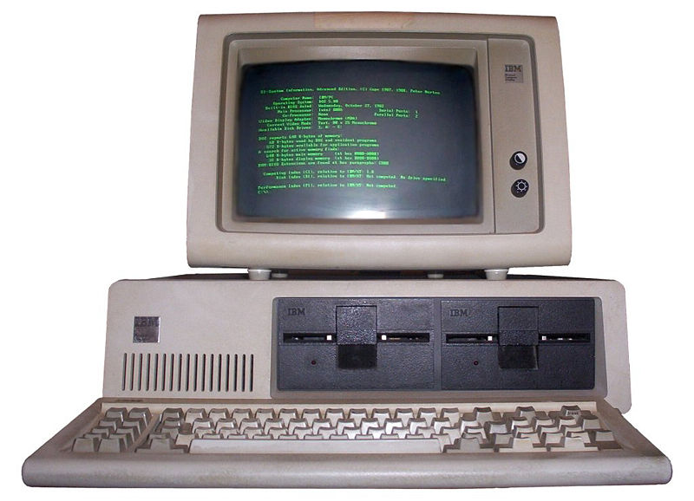
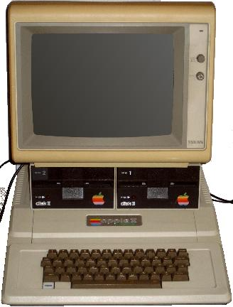
The same logic applies to the IBM –Intel- Microsoft vs. APPLE case
Apple II
PC IBM

Slide 25
3 remarks
1) Bandwagon vs. negative feedback
If someone is experiencing a positive feedback and has competitors, these latter are probably experiencing a negative feedback
The higher is the number of users of a platform, the higher is the incentive for the developers of complementary goods (sw) to create contents for such platform, the higher is the attractiveness of the platform, the higher is the number of users that use the platform (bandwagon effect or positive network feedback) and so on…
The lower is the number of users of a platform, the lower is the incentive for the developers of complementary goods (sw) to create contents for such platform, the lower is the attractiveness of the platform, the lower is the number of users that use the platform (negative network feedback) and so on…

Slide 26
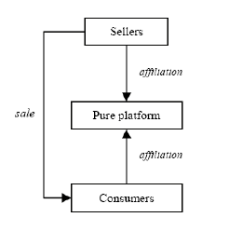
2) These dynamics also affect “Two-sided markets”
Rochet & Tirole (2006, RAND): “markets where one enable interactions between end-users, and try to get the two sides “on board”
Rysman (2009, JEP): “a two-sided market is one in which 1) two sets of agents interact through an intermediary or platform, and 2) the decisions of each set of agents affects the outcomes of the other set of agents, typically through an externality.”
Examples: on-line auctions, credit cards, crowdfunding

Slide 27
Videogames industry as a 2-sided market
Game developers
Consumers
Right to develop
Console producers

Slide 28
3) EMPIRICAL ESTIMATES OF NETWORK EXTERNALITIES
Large number of studies in the economics-managerial literature that document the presence of network externalities:
Indirect. Software (Dranove and Gandal, 1999; Gandal et al., 1999), ATMs (Saloner and Shepard, 1995), CD players (Gandal et al., 2000), Yellow Pages (Rysman, 2002), Videogames (Clements and Ohashi 2005), Cryptocurrency (Gandal and Halaburda, 2014), Electrical Vehicles (Li et al. 2017).
Direct Telecommunications services (Majumdar and Venkataraman 1998), Mobile phones (Baraldi 2012).

Slide 29
How to estimate them?
From Koski and Kretschmer (2008, JICT):
The complementary goods approach (e.g. Gandal et al. 2000) derives a system of equations and uses the number of software available as a variable in hardware adoption regressions and vice versa.
[In the hedonic approach (e.g.Gandal, 1994, Sarnikar, 2002), the installed base is treated as a product characteristic that will have a positive effect on prices if there are network effects].
[In the adoption approach (e.g. Koski, 1999, Gandal et al., 1999), the installed base at t-1 carries a positive expected sign in the adoption or diffusion equation at t.]
[The timing approach (e.g. Saloner and Shepard, 1995) establishes that firms with higher expected network effects will adopt a technology earlier and proxies expected network benefits by the number of potential (internal) users of the technology]

Slide 30
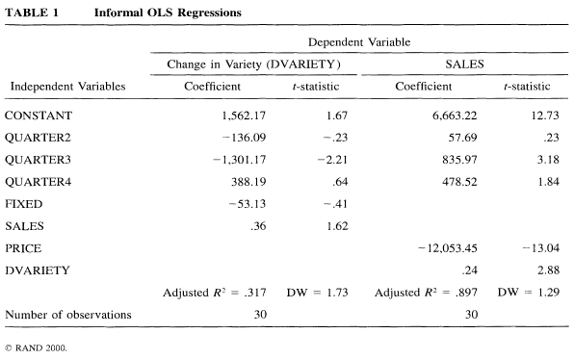
Complementary goods approach (e.g. Gandal et al. 2000 Rand, CD market USA, 1985-1992)

Slide 31
Complementary goods approach (e.g. Li et al. 2017 J. of the Assoc. of Env. & Res. Economists, EV market USA, 2011-2013)

Slide 33
ESSENTIAL REFERENCES
(for this and upcoming lectures on network economics)
L. Cabral, Introduction to Industrial organization, I edition, 2000, Chapter 16.
J. H. Rohlfs, 2001, Bandwagon effects in high-technology industries, MIT, Boston, Chapters 3,4,5.
Additional:
C. Shapiro e H. R. Varian, 1999, Information rules, ETAS Libri
Peter Grindley, 1995, Standards, Strategy, and Policy,Cases and Stories, Oxford University Press.
L. Cabral, Introduction to Industrial organization, II edition, 2018, Chapter 16.

